Slide 1
Ch#6 Big Data Processing Concepts
Dr Ahmed Awais

Slide 2
Quick Questions – Write answers on your 📔
Give an example of Big Data?
How is Big Data Collected?
What are the pros and cons of Big Data?

Slide 3
Possible answers
Social media activity is big data, through which these social media like Facebook or Twitter create massive amounts of user-generated content including posts, comments, likes, and shares in real time.
Big data is generated from various sources, including sensors, IoT devices, social media platforms, transactional systems, and web logs. These sources generate tremendous amounts of data, which are collected and stored using tools and frameworks for data collection, followed by processing and analysis in order to glean organization-level information.
Pros include unearthing valuable insights, improving decision-making, enriching customer experiences, and innovation as a form of strategy through data.
Cons include issues with data privacy and security, managing complexity in large datasets, high infrastructure costs, and the risk of misinterpretation of data if not appropriately analyzed.

Slide 4
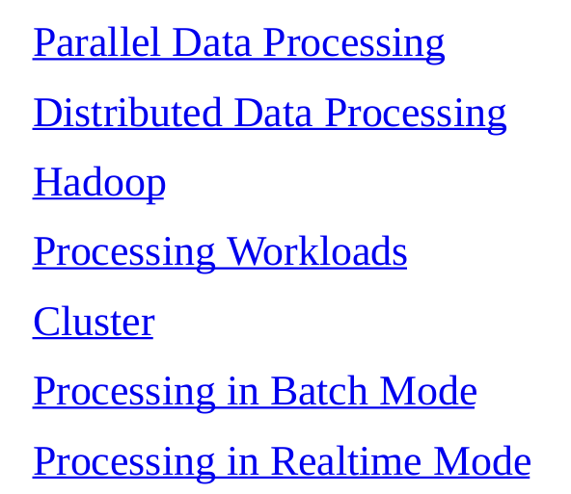
Chapter Outline

Slide 5
Parallel Processing Architecture
Single machine
Multi-core CPUs
Data split into chunks
Processed simultaneously
Notes:
Explain CPU cores. Give example of sorting large dataset using threads.

Slide 6
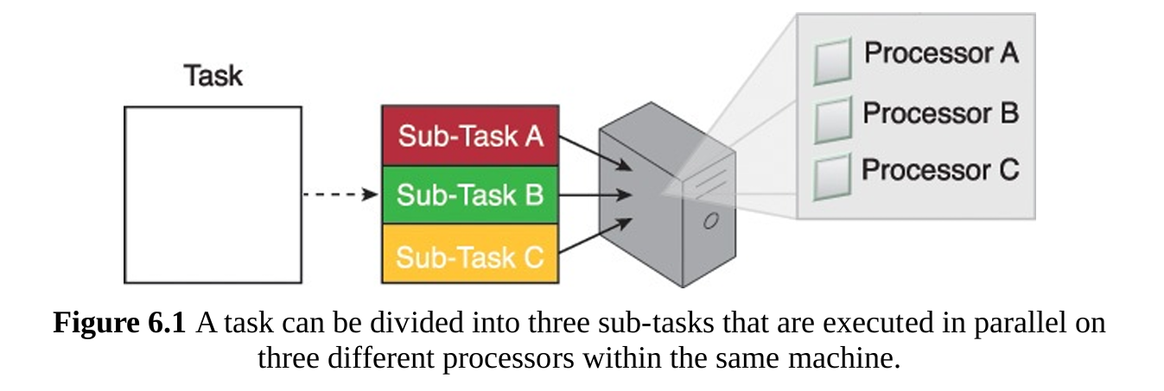
Parallel Processing Architecture
The goal is to reduce the execution time by dividing a single larger task into multiple smaller tasks that run concurrently
Notes:
Explain CPU cores. Give example of sorting large dataset using threads.

Slide 7
Distributed Processing Architecture
Multiple machines (nodes)
Data distributed
Parallel execution across nodes
Results aggregated
Notes:
Explain cluster computing. Mention Google, Amazon systems.

Slide 8
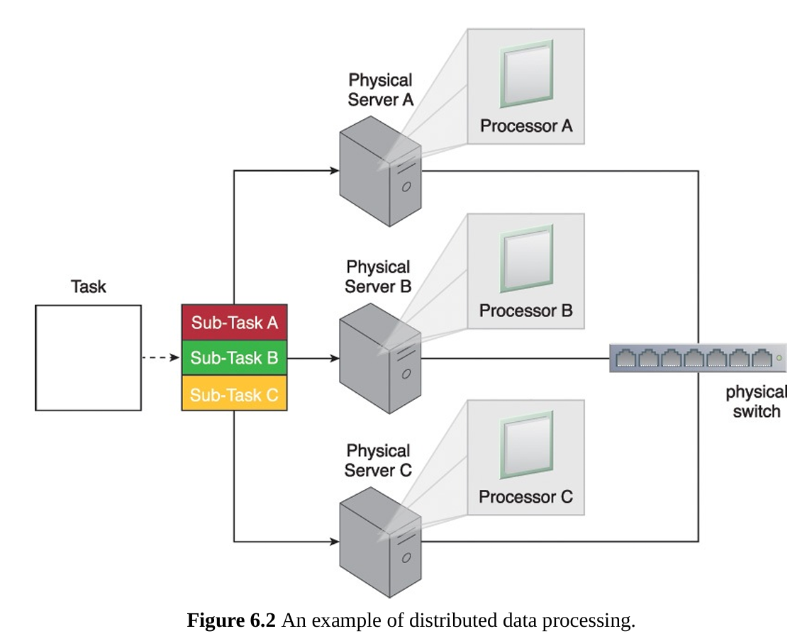
Distributed Processing Architecture
Notes:
Explain cluster computing. Mention Google, Amazon systems.

Slide 9
Parallel vs Distributed
Parallel: single system
Distributed: multiple systems
Scalability vs simplicity
Notes:
which is better for Big Data and why.

Slide 10
Hadoop Ecosystem
HDFS: storage
MapReduce: processing
Fault tolerance
Scalability
Notes:
The key discussion here data splitting across nodes and fault tolerance via replication.

Slide 11
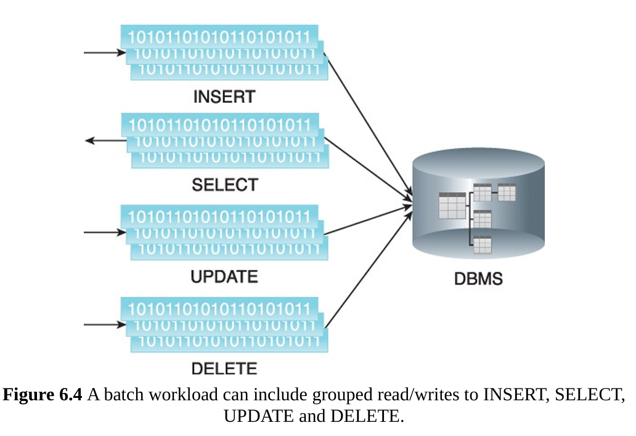
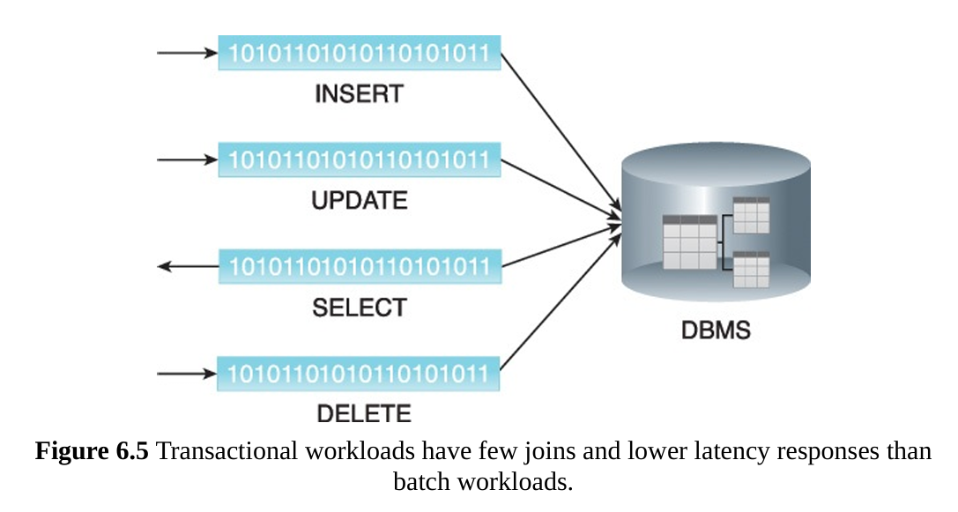

Slide 12
MapReduce Pipeline
Map phase: process chunks
Shuffle: group keys
Reduce: aggregate results
Notes:
Use word count example. Emphasize parallelism.

Slide 13
Processing Workloads
CPU-intensive
I/O-intensive
Mixed workloads
Notes:
examples: video processing vs database queries.

Slide 14
Cluster Architecture
Group of machines
Master-slave model
Resource sharing
Fault tolerance
Notes:
Explain how clusters improve performance and availability.

Slide 15
Batch Processing Pipeline
Collect data
Store data
Process periodically
Generate reports
Notes:
Example: daily sales reports. High latency but high throughput.

Slide 16
Real-Time Processing Pipeline
Data streams
Immediate processing
Low latency
Continuous output
Notes:
Example: fraud detection, stock trading.

Slide 17
Batch vs Real-Time
Batch: historical analysis
Real-time: instant decisions
Trade-off: latency vs throughput
Notes:
Which one to use in Netflix recommendations.

Slide 18
Concept | Definition | Key Characteristics | Advantages | Limitations | Real-World Example
Parallel Processing | Processing data simultaneously on multiple CPU cores (single machine) | Multi-core, shared memory, fast execution | Faster than sequential processing | Limited scalability (single machine) | Multi-threaded data sorting
Distributed Processing | Processing data across multiple machines (nodes) | Network-based, data distributed, scalable | Handles Big Data, high scalability | Network overhead, complexity | Google search processing
Hadoop | Framework for distributed storage & processing | HDFS + MapReduce, fault-tolerant | Scalable, cost-effective | Batch-oriented, higher latency | Log processing systems

Slide 19
Feature | Parallel | Distributed
Machines | Single | Multiple
Scalability | Low | High
Speed | Fast | Very fast
Complexity | Low | High
Feature | Batch Processing | Real-Time Processing
Data Type | Historical | Streaming
Latency | High | Low
Output | Delayed | Instant
Use Case | Reports | Alerts/Monitoring

Slide 20
Concept | Definition | Key Characteristics | Advantages | Limitations | Real-World Example
Processing Workloads | Type of processing tasks | CPU-intensive, I/O-intensive, mixed | Helps optimize system design | Misclassification affects performance | ML training (CPU), DB queries (I/O)
Cluster | Group of connected machines acting as one system | Distributed nodes, resource sharing | High availability, scalability | Setup & maintenance complexity | Data centers (AWS clusters)
Batch Processing | Processing large data in chunks at intervals | High latency, high throughput | Efficient for large datasets | Not real-time | Monthly salary processing
Real-Time Processing | Processing data instantly as it arrives | Low latency, continuous streams | Immediate insights, fast decisions | Complex system design | Fraud detection, stock trading

Slide 21
Case Study: Netflix
Real-time recommendations
Batch content analysis
Distributed systems
Notes:
Explain how Netflix uses both batch and streaming.

Slide 22
Case Study: Healthcare
Real-time patient monitoring
Batch medical reports
Data privacy
Notes:
Relate to ICU monitoring and alerts.

Slide 23
Case Study: Finance
Fraud detection (real-time)
Risk analysis (batch)
High-frequency trading
Notes:
Explain importance of low latency.

Slide 24
Conclusion
Big Data requires distributed systems
Choose right processing model
Real-world hybrid systems

